Slide 1

Modern Database Management
Thirteenth Edition
Chapter 10
Big Data Technologies
Slides in this presentation contain hyperlinks. JAWS users should be able to get a list of links by using INSERT+F7
Copyright © 2019, 2016, 2013 Pearson Education, Inc. All Rights Reserved
Notes:
If this PowerPoint presentation contains mathematical equations, you may need to check that your computer has the following installed:
1) MathType Plugin
2) Math Player (free versions available)
3) NVDA Reader (free versions available)

Slide 2
Learning Objectives
10.1 Define terms
10.2 Describe why database management extends beyond relational D B s and D W s
10.3 List the main No S Q L D B M S categories
10.4 Understand Mongo D B as an example of a No S Q L database
10.5 Choose between relational and No S Q L databases
10.6 Describe meanings and demands of big data
10.7 List and describe components of Hadoop environment
10.8 Understand the basics of Pig and Hive

Slide 3
Introduction
Big Data
Data that exist in very large volumes and many different varieties (data types) and that need to be processed at a very high velocity (speed).
Analytics
Systematic analysis and interpretation of data—typically using mathematical, statistical, and computational tools—to improve our understanding of a real-world domain.
Notes:
This chapter is primarily about these two new advances in data technologies and approaches.
Traditional data management technologies were created to ensure accurate and efficient transaction processing. As we saw from Chapter 9, later database structures were created to support decision-making and overall understanding of the business. We called these data warehouses. Big data and analytics take us further down this road.

Slide 4
Characteristics of Big Data (1 of 2)
The Five V’s of Big Data
Volume – much larger quantity of data than typical for relational databases
Variety – lots of different data types and formats
Velocity – data comes at very fast rate (e.g. mobile sensors, Web click stream)
Veracity – traditional data quality methods don’t apply; how to judge the data’s accuracy and relevance?
Value – big data is meaningless if it does not provide value toward some meaningful goal

Slide 5
Characteristics of Big Data (2 of 2)
Schema on Read, rather than Schema on Write
Schema on Write – preexisting data model, how traditional databases are designed (relational databases)
Schema on Read – data model determined later, depends on how you want to use it (X M L, J SON)
Capture and store the data, and worry about how you want to use it later
Data Lake
A large integrated repository for internal and external data that does not follow a predefined schema
Capture everything, dive in anywhere, flexible access
Notes:
Big data processing is done in batch mode, and may take hours to sift through the huge volume of data for an analytical task.
Big Data processing via Hadoop is good for long analytical tasks but not so good for exploring individual cases and their relationships. For this, relational databases and data warehouses are better.

Slide 6
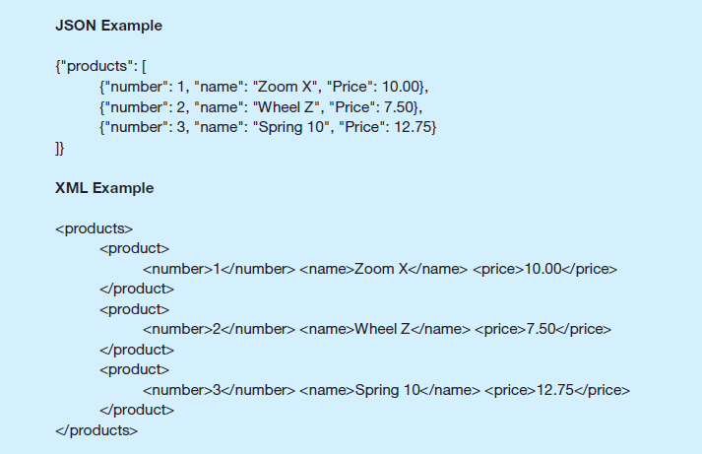
Figure 10-1 Examples of J SON and X M L
J SON = JavaScript Object Notation X M L = eXtensible Markup Language
Notes:
Both JSON and XML provide a semi-structured means of representing data hierarchically. JSON is also a major component of the JavaScript language.

Slide 7
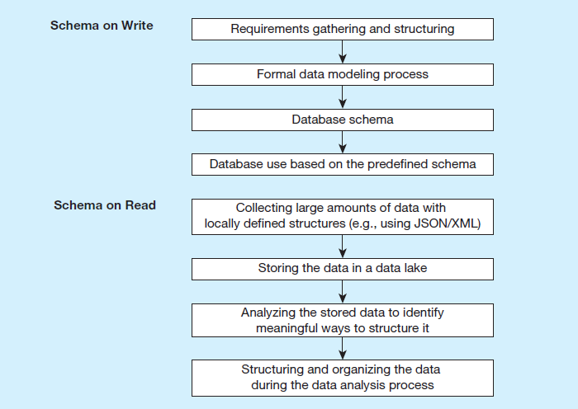
Figure 10-2 Schema on Write versus. Schema on Read
The big data approach
Traditional database design

Slide 8
No S Q L
No S Q L = Not Only S Q L
A category of recently introduced data storage and retrieval technologies not based on the relational model
Scaling out rather than scaling up
Natural for a cloud environment
Supports schema on read
Largely open source
Not ACID compliant!
B A S E – basically available, soft state, eventually consistent

Slide 9
No S Q L Classifications (1 of 2)
Key-value stores
A simple pair of a key and an associated collection of values. Key is usually a string. Database has no knowledge of the structure or meaning of the values.
Exampe: Redis
Document stores
Like a key-value store, but “document” goes further than “value”. Document is structured so specific elements can be manipulated separately.
Example: Mongo D B

Slide 10
No S Q L Classifications (2 of 2)
Wide-column stores
Rows and columns. Distribution of data based on both key values (records) and columns, using “column groups/families”
Example: Apache Cassandra
Graph-oriented database
Maintain information regarding the relationships between data items. Nodes with properties. Connections between nodes (relationships) can also have properties.
Example N e o 4 j

Slide 11
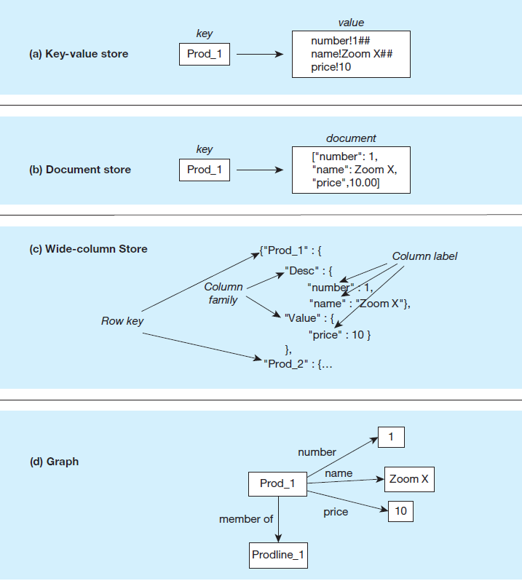
Figure 10-3 Four-Part Figure Illustrating No S Q L Databases
Some of the example structures have been adapted from Kauhanen (2010)

Slide 12
Table 10-2 Comparison of No S Q L Database Characteristics
Source: www.slideshare.net/bscofield/nosql-codemash-2010. Courtesy of Ben Scofield.
Blank | Key-Value Store | Document Store | Column Oriented | Graph
Performance | High | High | High | Variable
Scalability | High | Variable/High | High | Variable
Flexibility | High | High | Moderate | High
Complexity | None | Low | Low | High
Functionality | Variable | Variable (Low) | Minimal | Graph theory
Notes:
NoSQL brings an exciting new dimension to the database profession.
Note that “NoSQL” does not mean “No SQL”. It means “Not Only SQL”. SQL will be a part of database systems for some time to come.

Slide 13
No S Q L Example: Mongo D B
A document-store database
B SON-based storage format (Binary J SON)
Collections
Equivalent to tables in a relational database
A set of documents intended to be stored together
Documents
Equivalent to rows in a relational database
Documents do not need to have the same structure (unlike rows)
_id property for uniquely identifying a row
Relationships
_id property serves as “primary key”
Another document can have a “foreign” key as another J SON property

Slide 14
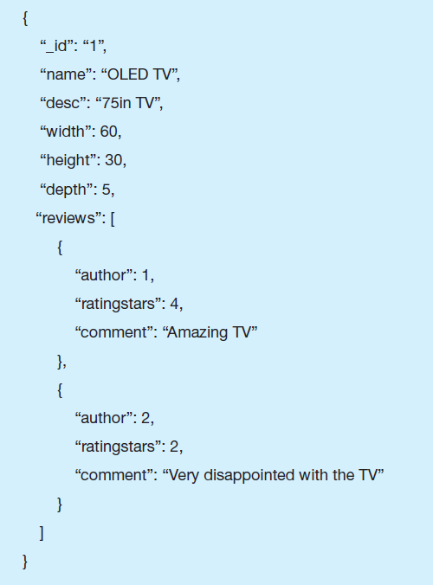
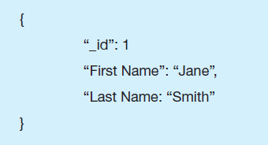
Figure 10-5 Sample Mongo Documents with Relationships
a) A document in the Product collection
b) A document in the Author collection

Slide 15
Hadoop
Hadoop is an open source implementation framework of MapReduce
MapReduce is an algorithm for massive parallel processing of various types of computing tasks
Hadoop Distributed File System (H D F S) is a file system designed for managing a large number of potentially very large files in a highly distributed environment
Hadoop is the most talked about Big-Data data management product today
Hadoop is a good way to take a big problem and allow many computers to work on it simultaneously
Notes:
A key feature of big data is highly distributed processing. The internet allows you to do this, by sharing tasks across hundreds or thousands of computers. Hadoop is made up of MapReduce and HDFS.
Hadoop’s essence is in processing very large amounts (terabytes or petabytes) of data by distributing the data and processing tasks among a large number of low-cost commodity servers. That means plain old PCs and servers.

Slide 16
Hadoop Distributed File System (H D F S)
A file system, not a D B M S, not relational
Breaks data into blocks and distributes them on various computers (nodes) throughout a Hadoop cluster
Each cluster consists of a NameNode (master server) and some DataNodes (slaves)
Overall control through Y A R N (“yet another resource allocator”)
No updates to existing data in files, just appending to files
“Move computation to the data”, not vice versa

Slide 17
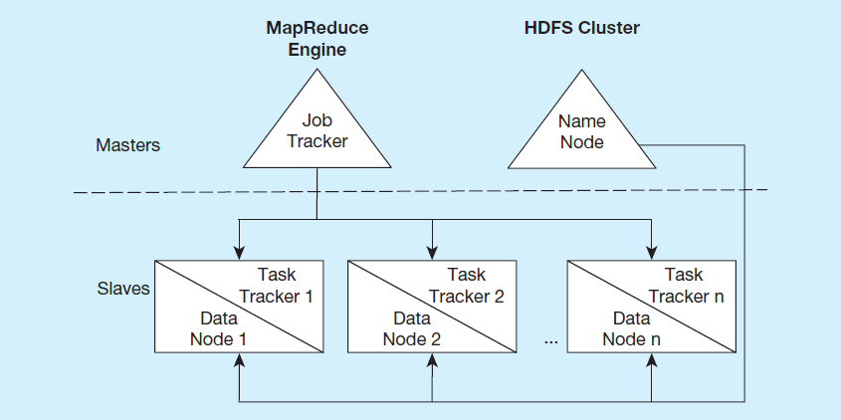
Figure 10-14 MapReduce and H D F S
Notes:
Hadoop is made up of the MapReduce engine and HDFS clusters. We’ll talk about each of these next. Note that the MapReduce engine includes an overall job tracker to manage activity on the entire cluster in the master server, and task trackers for each slave of the cluster. Each slave is a data node, and the master is a name node.

Slide 18
MapReduce
Enables parallelization of data storage and computational problem solving via many commodity servers
Programmers don’t have to be experts at parallel processing
Core idea – divide a computing task so that multiple nodes can work on it at the same time
Each node works on local data doing local processing
Two stages:
Map stage – divide for local processing
Reduce stage – integrate the results of the individual map processes
Notes:
Parallel programming existed before MapReduce, but it is very complicated. MapReduce purports to simplify this a lot.
A key element is the use of commodity computers (just regular PC technology). Historically massive parallelism involved supercomputers. Here it involves networked regular CPUs and disk drives.

Slide 19
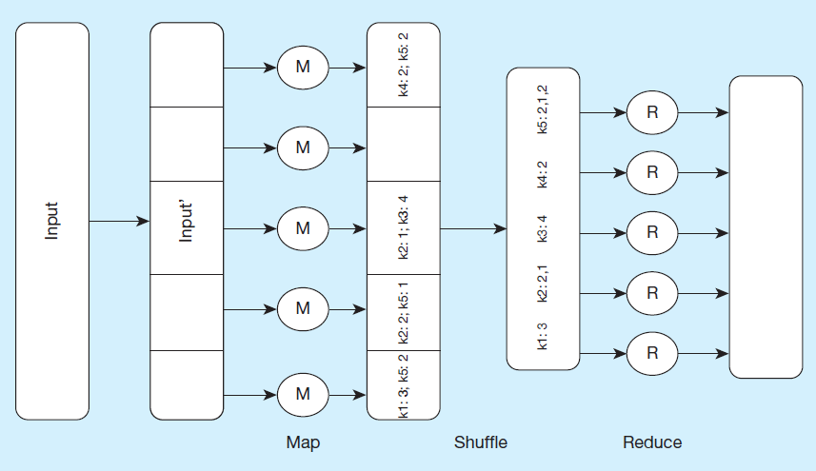
Figure 10-15 Schematic Representation of MapReduce
MapReduce: Simplified Data Processing on Large Clusters, Jeff Dean, Sanjay Ghemawat, Google, I n c., https://research.google.com/archive/mapreduce-osdi04-slides/index-auto-0007.html. Courtesy of the authors.
Notes:
In this example, the form of this data is in key-value pairs. So, the keys in the figure are k1, k2, etc. Assume that the problem is to get an overall count of how many times the key appears in the data. For example, consider that the keys are customer IDs and the values are individual orders for each customer. So, we’re trying to figure out how many orders each customer made. Also assume that the original input data is very, very, very large. In other words, bigger than what a single relational DBMS can handle.
The original input data is received at the master and then divided into subsets, each of which goes to an individual slave node. So, each slave node gets some number of sales orders. This is the map process. There may be hundreds of these nodes.
Each node works on its subset of the data. Its task is to find out how many orders for each customer. So for example, the node at the bottom found 3 k1 orders and 2 k5 orders. Note that multiple nodes may have found examples of the same key. For instance, k2 is found in two of the nodes.
The shuffle step is at the end of mapping, and merges all the map outputs and packages them for the reduce phase. At this point, we’ve collected all results and grouped them by key value.
The reduce stage integrates the results of each of the map processes, creating the final result
It is up to the developer to define the mapper and the reducer so that they together get the work done. So, MapReduce programming involves writing code to do the mapping and writing code to do the reducing.

Slide 20
Other Hadoop Components
Pig
A tool that integrates a scripting language and an execution environment intended to simplify the use of MapReduce
Useful development tool
Hive
Supports management and querying of large data sets
Hive Q L – S Q L-like language for managing Hadoop data
Useful for E T L tasks
H Base
A wide-column store database that runs on top of H D F S
Not as popular as Cassandra
Notes:
Pig and Hive help to make Hadoop more accessible to traditional developers.

Slide 21
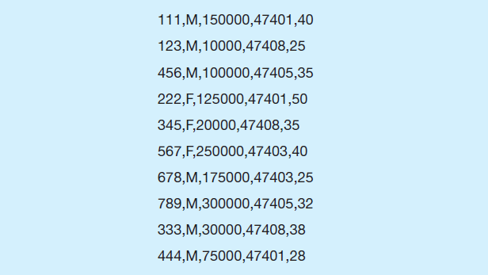
Figure 10-16 Sample Data Set for Pig and Hive Examples
Sample data in C S V (comma separated values). This is just a text file.
Notes:
Obviously, this is not a relational database, and there is no metadata to be found. It’s just a text file.
CSV splits the data using a comma as a separator. You could also have tab-separated files, or other characters as the separator.

Slide 22
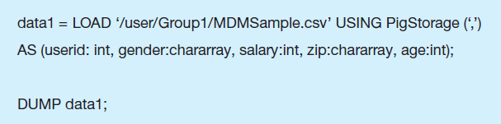
Figure 10.18 Sample Pig Script to Load Data from a C S V File
LOAD reads the data as tuples. USING specifies the separator between fields. AS specifies the names and data types for each item on a line. DUMP returns the results.
Notes:
A tuple is a row of data.
This is a classic example of Schema on Read. The data itself has no inherent metadata. It’s just text.
Thus, the metadata is done on the fly, and could change depending on how you want to use the data. This is very different from how metadata is done in a relational database.

Slide 23
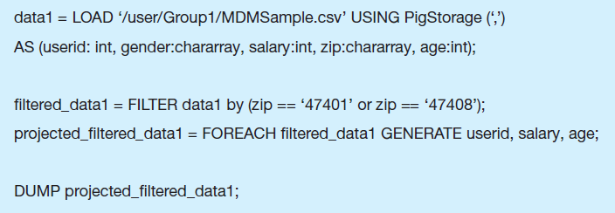
Figure 10.22 Sample Pig Script with FILTER and GENERATE Clauses
FILTER is like a WHERE clause in S Q L. FOREACH loops through the rows. GENERATE specifies the values returned (kind of like the SELECT clause in S Q L).

Slide 24
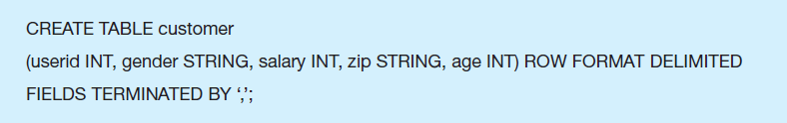
Figure 10.24 Sample CREATE TABLE Query in Hive
Hive is a S Q L-like language. Like Pig, it can apply to C S V text files and incorporated Schema on Read.

Slide 25
Integrated Analytics and Data Science Platforms
Some vendors are bringing together traditional data warehousing and big data capabilities
Examples
H P H SAVE n – Hewlett Packard technologies combined with Hadoop open source and an analytics engine
Teradata Aster – integrate S Q L, graph analysis, MapReduce, R
I B M Big Data Platform – combine I B M technologies with Hadoop, J SON Query Language (J A Q L),D B 2, Netezza

Slide 26
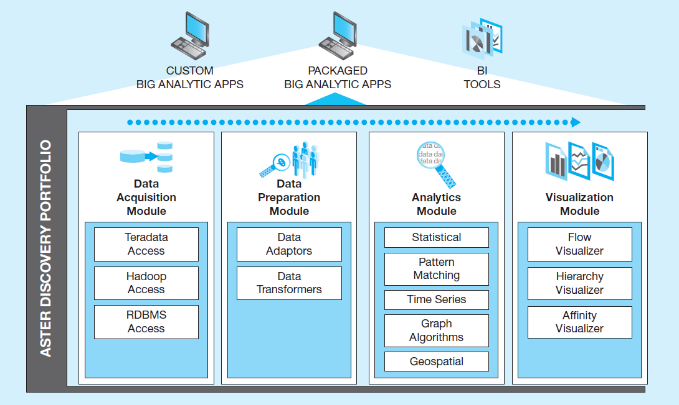
Figure 10-31 Teradata Aster Discovery Portfolio
Source: http://www.teradata.com/Teradata-Aster-Discovery-Portfolio. Courtesy of Teradata Corporation.

Slide 27
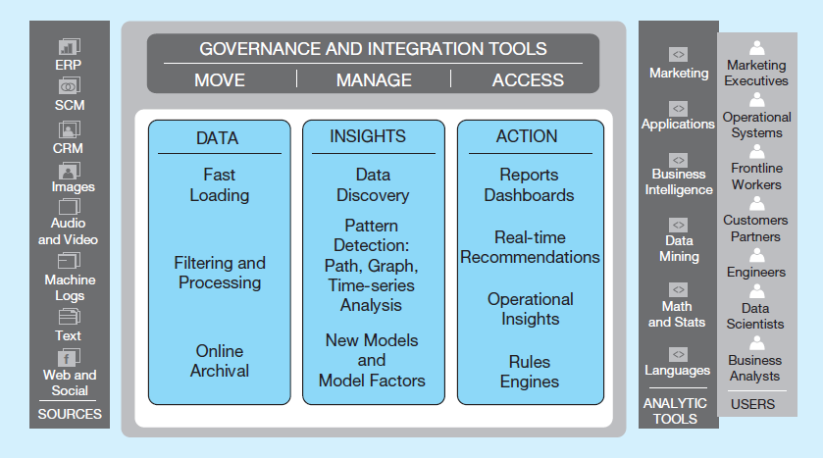
Figure 10-32 Teradata Unified Data Architecture: Logical View
Source: http://www.teradata.com/Resources/White-Papers/Teradata-Unified-Data-Architecture-in-Action. Courtesy of Teradata Corporation.
Notes:
Here we see the system conceptual view. Notice the intersection of Teradata’s proprietary database engine with Hadoop, and the use of Aster for discovery. The Data Platform allows for capturing data from the sources and prepare and store it for analytical purposes.

Slide 28
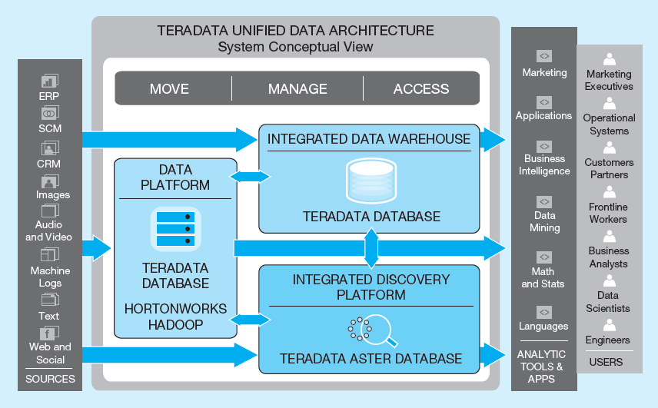
Figure 10-33 Teradata Unified Data Architecture: System Conceptual View
Source: http://www.teradata.com/Resources/White-Papers/Teradata-Unified-Data-Architecture-in-Action. Courtesy of Teradata Corporation.
Notes:
This is Teradata’s model of how various elements of a modern data management environment belong together. Here we see a logical view. Data sources are at one end and users at another. In between are three core activities: data, insights, and actions.

Slide 29

Copyright

